Slide 1
3rd IEEE Global Conference GCWCN-2025 (TKD-25)
( Hybrid Mode)
November 22-23, 2025
Theme: “Digitization of New Techniques in Next Generation Networks”
In Association with IEEE Bombay section, CTIF Global Capsule , GISFI India and IEEE SITSB Lonavala
Paper ID : 79 and Track : Green ICT
SmartWasteNet: A Deep Learning Framework to Transition from Take-Make-Waste to Rethink-Redesign-Reuse for Circular Economy under SDG 12
Sighakolli Naga Tirumala Rao, Shaik Rasheed, Vattikuti Hemanth, Kumbha Chandra Sekar, Karanam Madhavi ,Dodda Venkata Reddy

Slide 2
Contents
1. Introduction
2. Literature Survey
3. Methodology
4. Model’s Implemented
5. Results & Discussios
6. Conclusions & Future
Scope
7. References

Slide 3
Rapid urbanization in India has led to a steep rise in Municipal Solid Waste (MSW).
Traditional Take–Make–Waste linear systems are not sustainable for cities.
SDG 12 promotes Responsible Consumption & Production, emphasizing Rethink, Redesign, Reuse principles.
Existing research covers CE in construction, manufacturing, e-waste, etc., but
city-level AI-driven CE action recommendations are missing.
This work introduces SmartWasteNet, a deep learning system that:
Analyzes city-level waste & sustainability indicators.
Clusters cities using an autoencoder.
Predicts CE actions using MLP models.
Provides explainable recommendations using SHAP.
Introduction

Slide 4
Literature Survey
No | Title | Author | Journal Name & Year | Methodology Adapted | Key Findings | Gaps
1 | CircularNet: A Deep Learning Framework for Lifecycle Intelligence under SDG 12 | R. Prakash, V. Jain | IEEE Trans. Computational Social Systems & 2024 | Deep Neural Networks, Autoencoder-based Lifecycle Mapping | Introduced lifecycle intelligence models for resource reuse | Lacked explainability and integration with national-level SDG indicators
2 | Forecasting Municipal Solid Waste Generation Using LSTM | A. Rahman, N. Gupta | Environmental Modelling & Software & 2023 | Long Short-Term Memory (LSTM), Time Series Forecasting | Achieved high accuracy in waste forecasting across cities | Focused on forecasting only, not on CE recommendations
3 | AI-Driven Waste Management and Circular Economy Transition | M. Singh, S. Reddy, P. Das | IEEE Access & 2024 | Machine Learning (MLP, SVM), Sustainability Indexing | AI models effectively optimized waste recycling strategies | Did not integrate SHAP explainability or CE action labels
4 | Explainable AI for Sustainable Development: A SHAP-Based Case Study | A. Bose, S. Bhattacharya, | Sustainable Computing: Informatics & Systems & 2024 | SHAP Explainability, Deep Learning Interpretation | Highlighted interpretability in AI for sustainability | Limited to small-scale datasets, not waste management applications
5 | Green Transition Models in Circular Economy | R. Bansal, A. Kaur | Journal of Cleaner Production & 2024 | Data Analytics, Circular Economy Index, Regression | Proposed indicators for measuring CE transitions | No predictive AI model for waste trends or actions

Slide 5
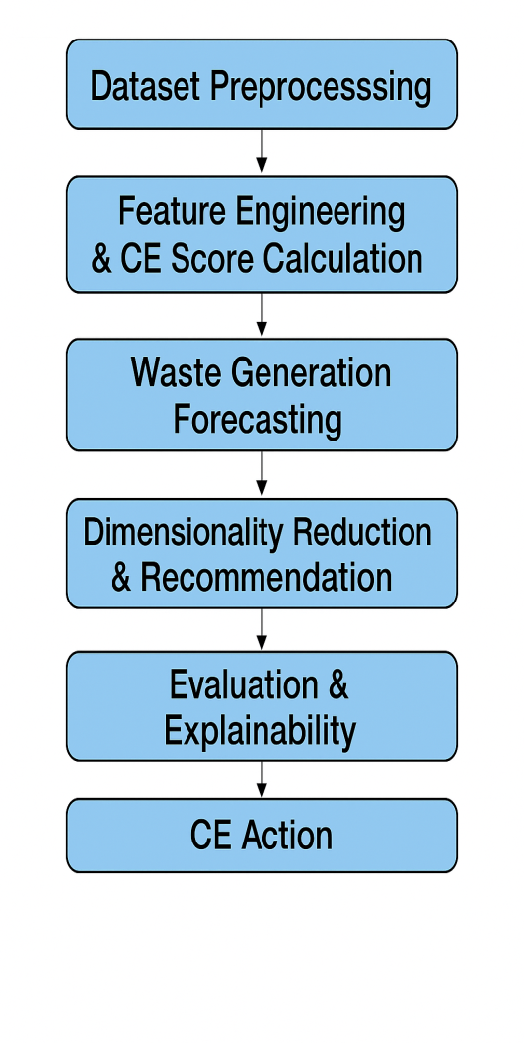
SmartWasteNet Workflow:
Data Collection (59 Indian cities):
  MSW generation, recycling %, composting %, population density,
  landfill stats, SDG 11 & SDG 12 scores.
Preprocessing:
  Missing value imputation, label encoding, z-score scaling.
  Feature selection using correlation & domain relevance.
Dimensionality Reduction:
  Autoencoder generates 2D latent vectors.
Clustering:
  K-means on latent space → 3 clusters → mapped to Rethink,
  Redesign, Reuse.
Classification:
  Five MLP variants trained to predict CE action labels.
Explainability:
  SHAP identifies most influential features (SDG 12, recycling rate,
  population density).
Methodology

Slide 6
Models Implemented
1. Autoencoder
Learns compressed latent representation of sustainability indicators.
2D latent vectors used for clustering cities into 3 CE groups.
2. MLP-Based CE Action Classifiers
Five deep learning models:
MLP 1-Layer
MLP 2-Layer
Dropout MLP
BatchNorm MLP
WideDeep MLP
Best Model:
Dropout MLP with 97.86% accuracy.

Slide 7
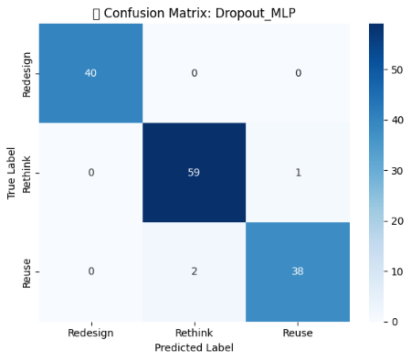
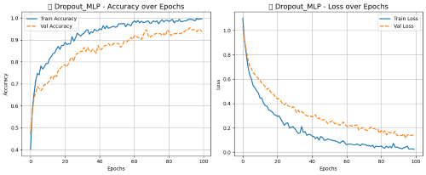
Results and Discussions
Autoencoder Clustering:
Created clear 3 clusters representing hidden CE characteristics.
Interpreted as:
  Cluster 1 – Rethink
  Cluster 2 – Redesign
  Cluster 3 – Reuse
Classifier Performance:
Dropout MLP → 97.86% Accuracy, 98% F1 Score.
Perfect classification in confusion matrix.
Training Analysis:
Dropout MLP shows smooth convergence with low gap between
training & validation curves → minimal overfitting.
SHAP Analysis:
Most significant predictors:
SDG 12 Score
Recycling Rate (%)
Population Density
These guide explainable city-specific CE recommendations.

Slide 8
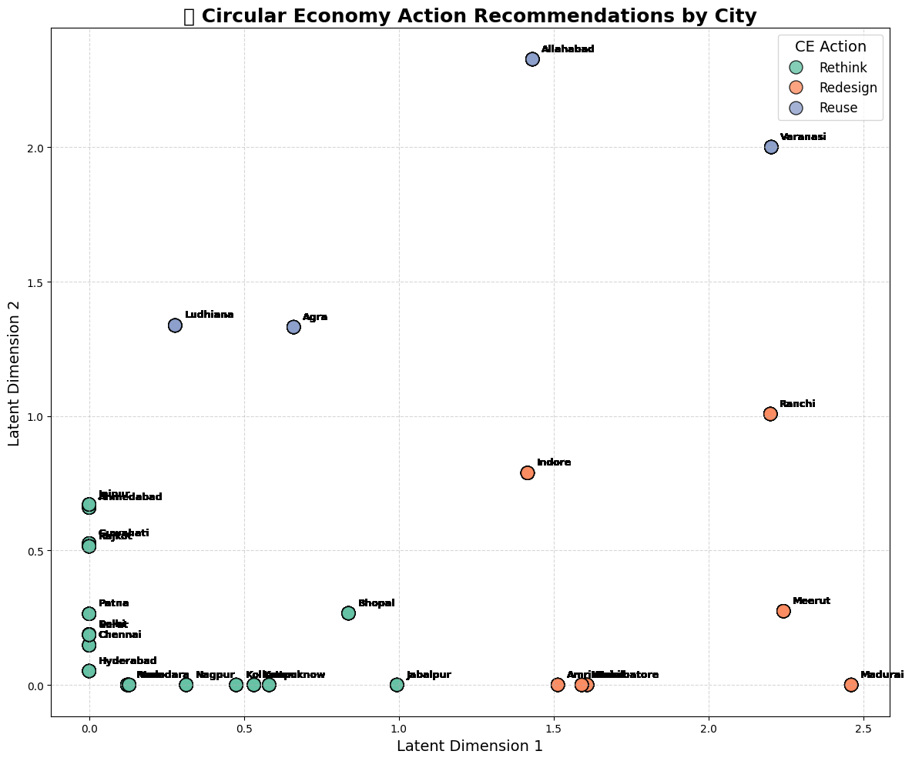
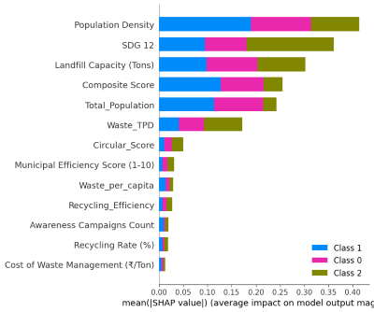
Results and Discussions
City-Level CE Recommendations
Cluster | CE Action | Description
0 | Rethink | High waste generation, low recycling rate.
1 | Redesign | Moderate waste, emerging recycling improvements.
2 | Reuse | Low waste, high recycling and SDG 12 score.

Slide 9
Conclusions and Future Scope
SmartWasteNet successfully integrates clustering, deep learning, and
explainability for CE planning.
Dropout MLP achieved 97.86% accuracy, outperforming other architectures.
SHAP insights highlight SDG 12, recycling %, population density as top drivers.
Provides a scalable tool for data-driven sustainable urban planning under SDG 12.
Future Scope
Integrate real-time sensor data and smart-bin IoT systems.
Extend framework to rural and international datasets.
Add geospatial analysis (GIS-based CE mapping).
Develop a government-facing decision-support dashboard.
Explore GNNs and transformers for improved city-level sustainability modeling.

Slide 10
References
Md. R. Hasan and M. R. Karim et al., "A Comparative Analysis of Forecasting Algorithms for Predicting Municipal Solid Waste Generation in Chittagong City," Elsevier, 2025.
2. I. Kayan and N. A. Oz et al., "Integrating response surface methodology and decision tree algorithms for valorization of cheese whey wastewater," Elsevier, 2025.
3. C. Bosco, K. N. Seglem, E. Sivertsen et al., "Developing a framework to assess water smartness and sustainability of circular economy solutions in the water sector," Elsevier, 2025.
M. M. Jayalath, H. N. Perera, and R. Jayasinghe, "Harvesting sustainability: Transforming traditional agrifood supply chains with circular economy in developing economies," Elsevier, 2025.
5. S. Jadhav and S. Patil et al., "Review of sustainable temporary housing and reuse strategy for post-disaster architectures: current trends and strategic gaps," Elsevier, 2025.

Slide 11


